Slide 1
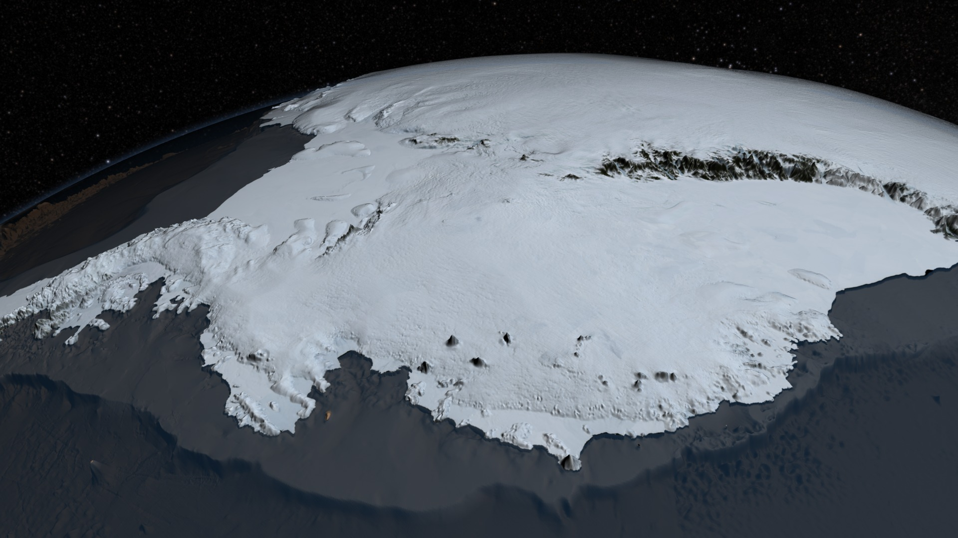

Polar Ice melt and Sea Level Rise
Antarctic Ice Sheet (Visualization from NASA's mission Operation IceBridge dataset BEDMAP2)
By Lea Fortmann and Penny Rowe with funding from the National Science Foundation.
Notes:
Image from https://en.wikipedia.org/wiki/Antarctic_ice_sheet#/media/File:AA_bedrock_surface.4960.tif

Slide 2
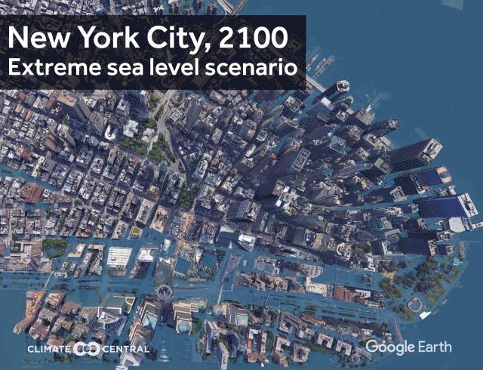
Learning Objectives and Module Overview
In this module you will explore:
Why is sea level rising and how are polar regions contributing?
What is storm surge and how will it affect us?
How should we prepare?
From Climate Central
(https://www.climatecentral.org/outreach/alert-archive/2017/2017SeaLevelCM-TVM.html)

Slide 3
Learning Objectives and Module Overview
In this module you will explore:
Why is sea level rising and how are polar regions contributing?
What is storm surge and how will it affect us?
How should we prepare?
From Climate Central
(https://www.climatecentral.org/outreach/alert-archive/2017/2017SeaLevelCM-TVM.html)

Slide 4
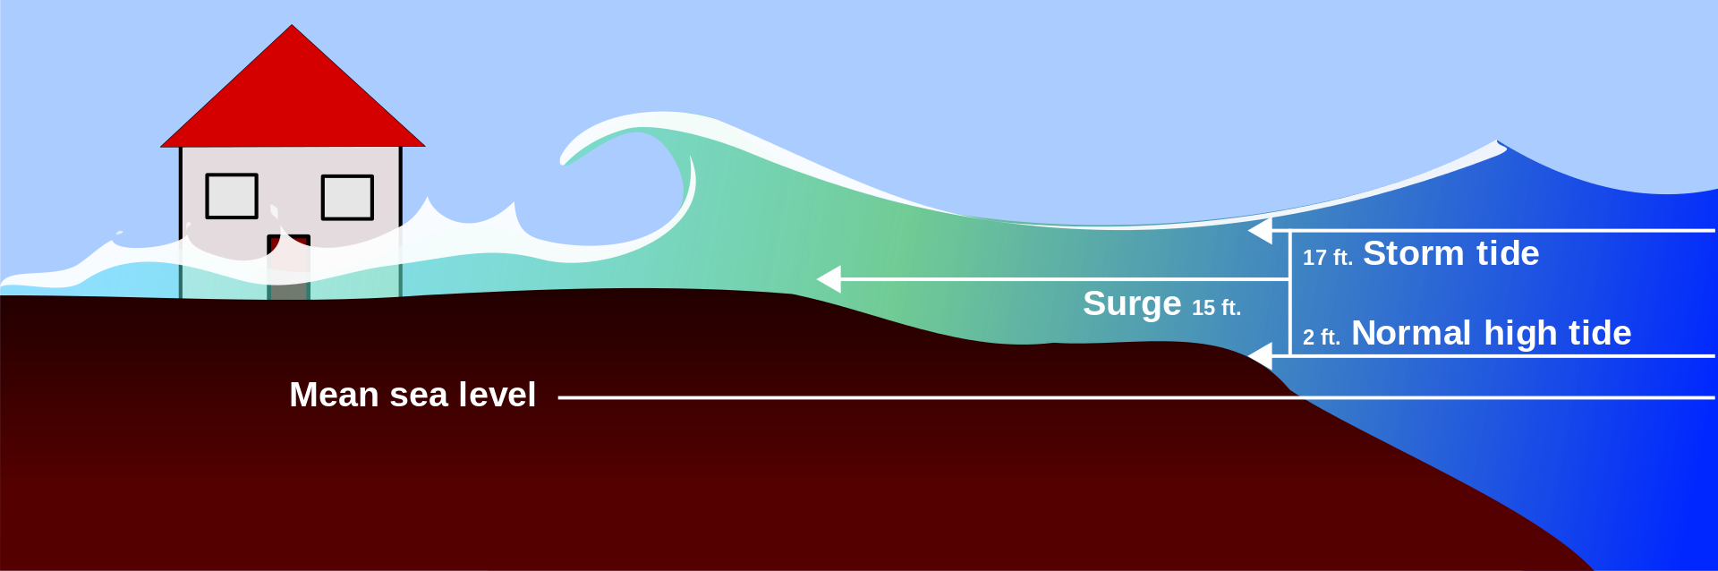
Storm Surge
Storm surge is a rise in sea level due to an intense storm.
Sea level rise adds to storm surge.
Flooding
Severe damage
Loss of lives
By SuperManu - Image:Surge big.jpg by Robert Simmon, NASA GSFC, via NOAA. Uploaded by Pierre cb, Public Domain, https://commons.wikimedia.org/w/index.php?curid=2264485
Notes:
NOAA 2018 Report: Assessing the U.S. Climate in 2017. Retrieved from website: https://www.ncei.noaa.gov/news/national-climate-201712
Picture source: https://abcnews.go.com/US/hurricane-harvey-wreaks-historic-devastation-numbers/story?id=49529063

Slide 5
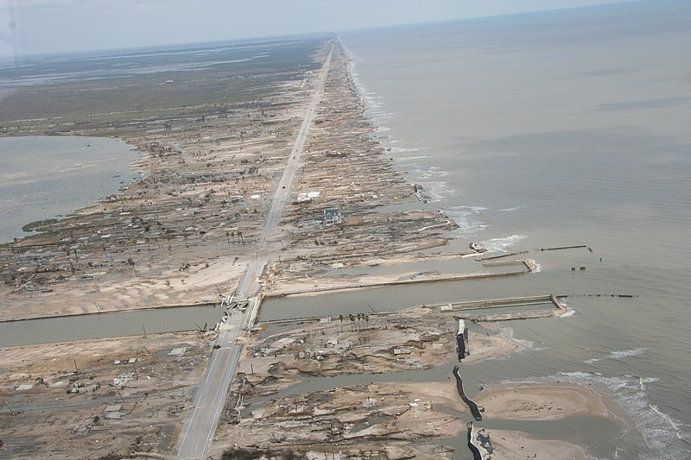
Storm Surge
Katrina (2005)
26 feet
Levees breached
1800 killed*
$125 billion
Hurricane Sandy (2012)
9 feet
$65 billion
Hurricane Harvey (2017)
10 feet
$125 Billion
* Not all due to storm surge
https://www.britannica.com/event/Hurricane-Katrina
https://www.nhc.noaa.gov/news/UpdatedCostliest.pdf
https://www.weather.gov/okx/HurricaneSandy
https://www.nhc.noaa.gov/data/tcr/AL182012_Sandy.pdf
Damage from Hurricane Ike’s storm surge (2008). Courtesy of the U.S. National Weather Service
https://www.nhc.noaa.gov/data/tcr/AL092017_Harvey.pdf
Notes:
NOAA 2018 Report: Assessing the U.S. Climate in 2017. Retrieved from website: https://www.ncei.noaa.gov/news/national-climate-201712
Picture source: https://abcnews.go.com/US/hurricane-harvey-wreaks-historic-devastation-numbers/story?id=49529063

Slide 6
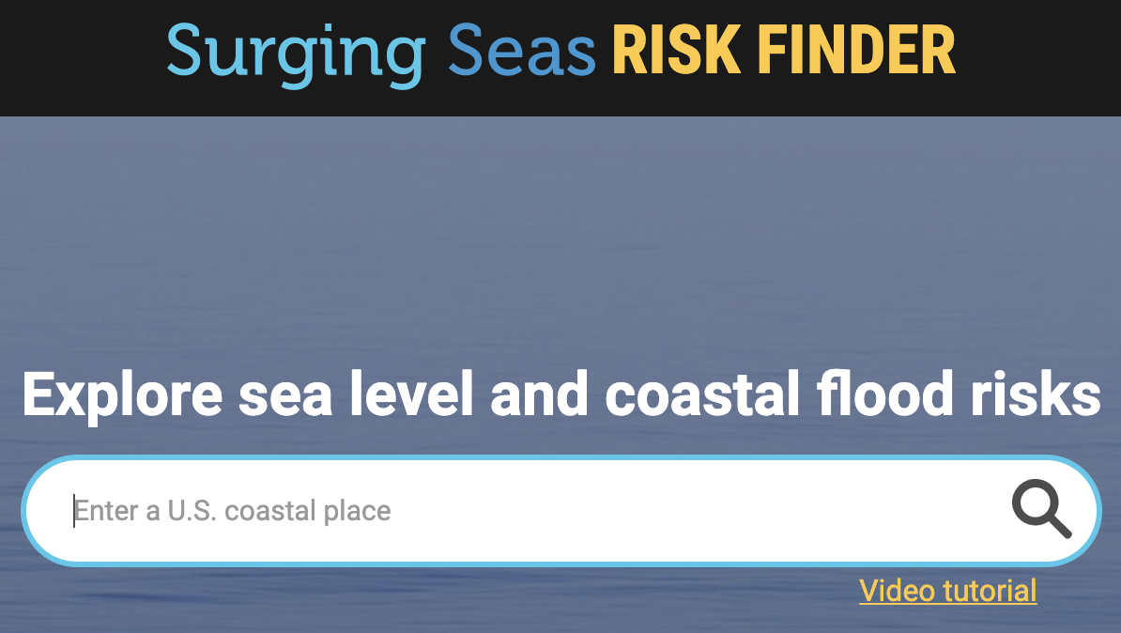
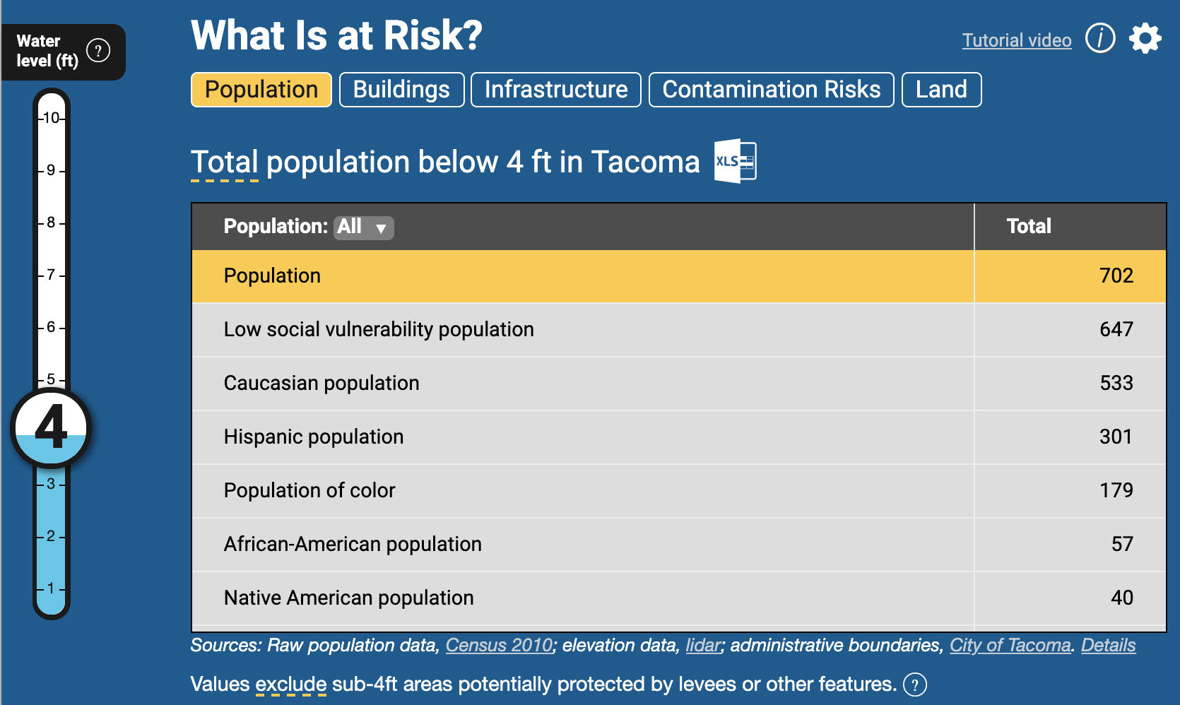
Local Sea Level Rise Impacts
How will sea level rise impact your local region through increased storm surges and flooding?
1. Go to the Surging Seas Risk Finder website that shows various impacts from flooding in coastal cities in the U.S. (https://riskfinder.climatecentral.org/)
2. Type in your city of interest (e.g. Tacoma)
3. Take 5 minutes to explore the website.
From Climate Central (https://riskfinder.climatecentral.org/)
Notes:
Riskfinder.org website: https://riskfinder.climatecentral.org/place/tacoma.wa.us?comparisonType=city-council-district&forecastType=NRC_High&level=4&unit=ft

Slide 7
Local Sea Level Rise Impacts
Based on information from the Risk Finder website, answer the following questions:
Look at the figure “When are the Risks?” What sea level rise scenarios are given?
Scroll down to the figure “What is at Risk?” The figure to the right shows the population at risk in Tacoma, WA at a water level of 4 ft. How many people in the population of your city are at risk given a water level of 6 ft?
How many homes are at risk given 8 ft of flooding? (Hint: click on the “Buildings” tab).
From Climate Central (https://riskfinder.climatecentral.org/)
Notes:
Riskfinder.org website: https://riskfinder.climatecentral.org/place/tacoma.wa.us?comparisonType=city-council-district&forecastType=NRC_High&level=4&unit=ft

Slide 8
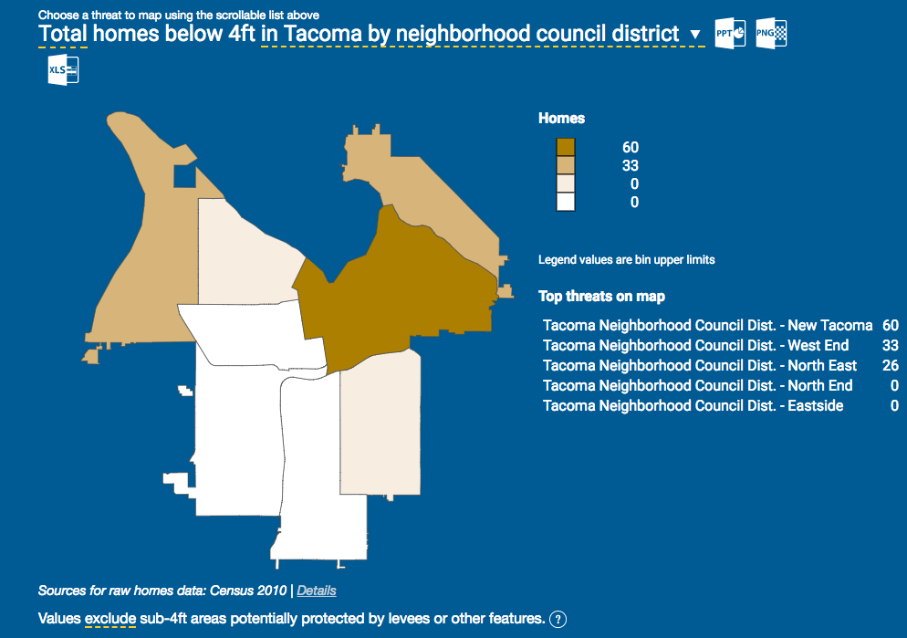
Part I: Estimating Home Values in Flood Prone Areas
With higher sea levels come increased storm surge and flooding. In this section you will estimate local damages associated with higher flood levels by estimating the property damage that would occur at each level of flooding based on regional housing values and the number of homes that are impacted. To start, follow the directions in red below.
To get housing values, go to the ArcGIS website here to find median home values in the U.S. for the year 2017.
Type your location of interest into the search bar at the top left of the screen then use the + button in the upper left corner to zoom into the area.
Click on a block to see the median home price in that block group for 2017.
Now look at the Surging Seas Risk Finder website for your city, (Tacoma, WA shown here) and scroll down to see what areas are most at risk due to flooding. Note: be sure to click on “Buildings” and then “Homes” under the "What is at Risk?” section to see the correct map.
Compare these two maps and decide on a representative median home price to use in the analysis for estimating flood damages.
Source: ESRI ArcGIS
Pause for Analysis: Think about or discuss with a partner how you decided on what home price to use for this analysis.
Source: Climate Central Risk Finder
Notes:
ArcGIS Housing data website: https://www.arcgis.com/apps/View/index.html?appid=d73c1eaca68c4520b66fa876bd67bb2e

Slide 9
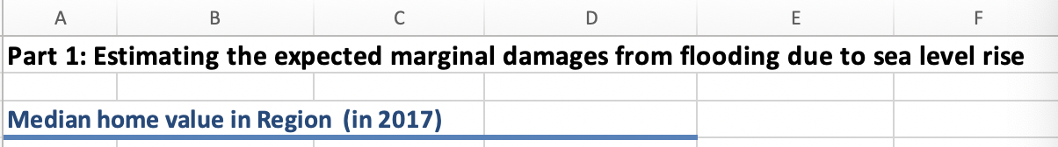
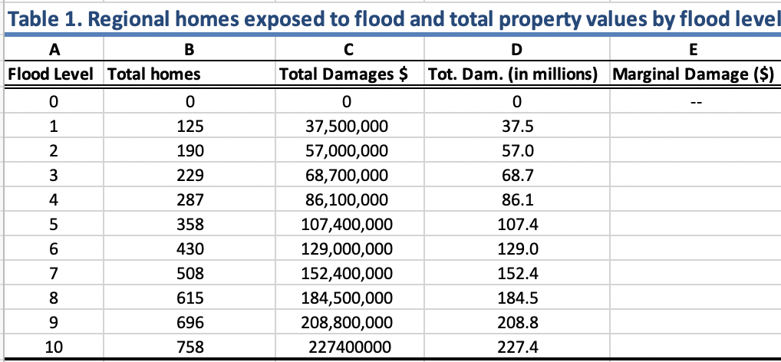
Part I: Calculating the Marginal Damage Cost of Flooding
Now that you have an median housing price, you will use this data to calculate the damages from flooding in your region based on the number of homes that will be impacted at various flood levels.
1. To get started, open the Excel file for “CGI SLR Module”, then click on the tab for “Part 1: MD Tables” at the bottom.
2. Look Table 1 to see the total number of homes that will be exposed at each level of flooding in your region*.
3. Use the median housing price you decided on from the previous slide and double click on cell D3. Type the value into your Excel spreadsheet and hit ‘enter’.
Notice Columns C and D in Table 1 populate with the total property damages at each flood level, which is calculated by multiplying the number of houses exposed (Column B) by the median home value you just typed in to get the total damage costs.
*Housing data displayed here is sourced from: Climate Central (2014). Sea level rise and coastal flood exposure in Tacoma, WA, in Surging Seas Risk Finder. Retrieved from ssrf.climatecentral.org/#p=L&state=Washington&location=WA_Town_5370000

Slide 10
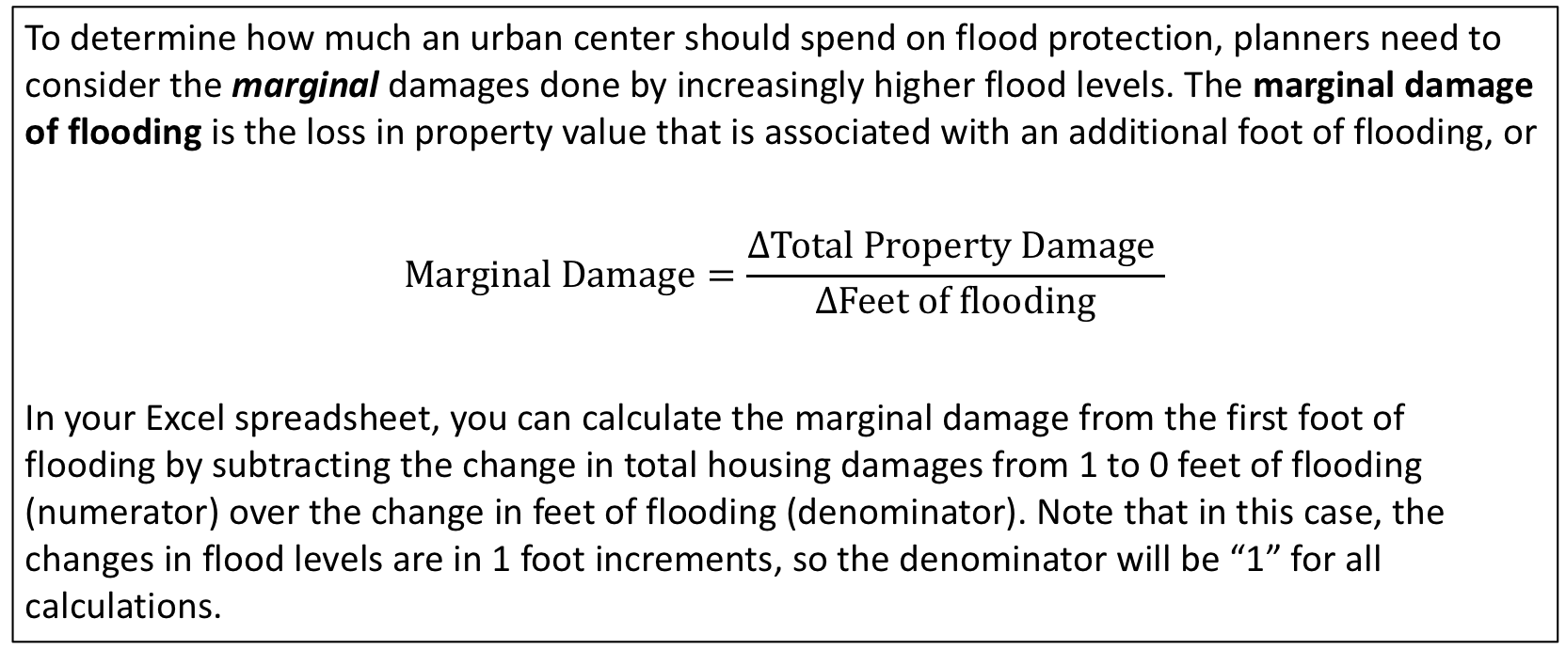
Part I: Calculating Marginal Damage Costs from Flooding
To determine how much an urban center should spend on flood protection, planners need to consider the marginal damages done by increasingly higher flood levels. The marginal damage of flooding is the loss in property value that is associated with an additional foot of flooding, or
$$Marginal Damage=\frac{∆Total Property Damage }{∆Feet of flooding}$$
In your Excel spreadsheet, you can calculate the marginal damage from the first foot of flooding by subtracting the change in total housing damages from 1 to 0 feet of flooding (numerator) over the change in feet of flooding (denominator). Note that in this case, the changes in flood levels are in 1 foot increments, so the denominator will be “1” for all calculations.

Slide 11
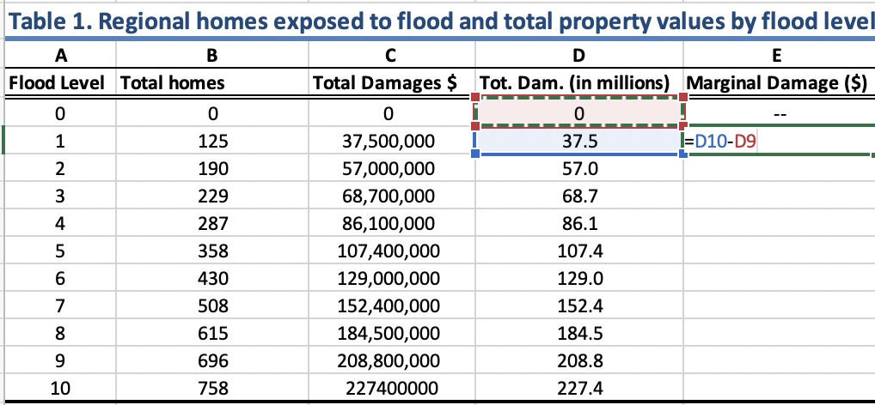
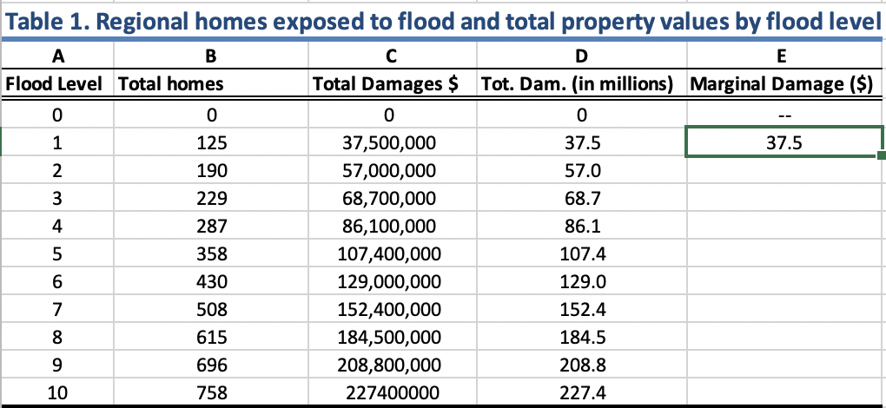
Part I: Calculating Marginal Damage Costs from Flooding
After reviewing the formula for calculating marginal damage costs on the previous slide, you will now apply it to your region by calculating the marginal damages from flooding from 0 to 10 feet in Table 1.
1. To calculate the marginal damages, subtract the total damages given 1 ft of flooding from damages with 0 ft of flooding, by typing the formula “=D10-D9” into cell E10, under Marginal Damages (column E) then hit ‘enter’.
2. Click on the cell to show the green border, then click on the square in the lower right corner and drag it down to the last cell in the column to copy the formula into these cells.
Excel Tip: You can also click on the cell to fill in the cell reference in the formula (e.g. D10) instead of typing it.
Pause for Analysis: In a group or with a partner, discuss what assumptions you are making about how flood damages will impact houses based on the calculations for marginal damages you just made here, i.e. interpret the value in the. Cell E10. Do you think this is an over or under estimate of flood damages?

Slide 12
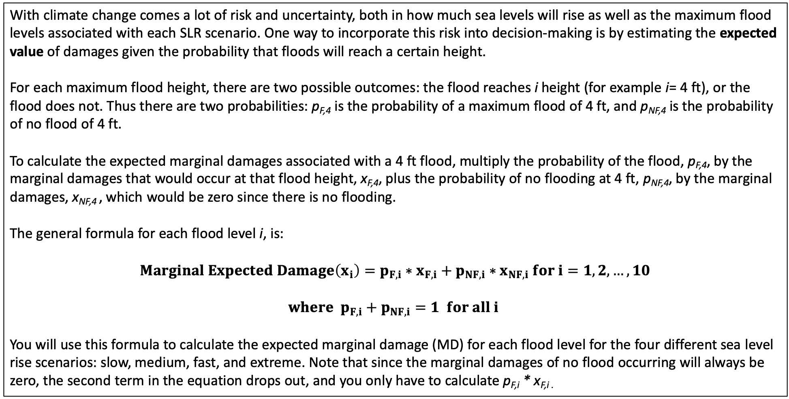
Part 1: Calculating Expected Damages from Flooding
With climate change comes a lot of risk and uncertainty, both in how much sea levels will rise as well as the maximum flood levels associated with each SLR scenario. One way to incorporate this risk into decision-making is by estimating the expected value of damages given the probability that floods will reach a certain height.
For each maximum flood height, there are two possible outcomes: the flood reaches i height (for example i= 4 ft), or the flood does not. Thus there are two probabilities: p_{F,4} is the probability of a maximum flood of 4 ft, and p_{NF,4} is the probability of no flood of 4 ft.
To calculate the expected marginal damages associated with a 4 ft flood, multiply the probability of the flood, p_{F,4}, by the marginal damages that would occur at that flood height, x_{F,4}, plus the probability of no flooding at 4 ft, p_{NF,4}, by the marginal damages, x_{NF,4} , which would be zero since there is no flooding.
The general formula for each flood level i, is:
$$Marginal Expected Damage\left(x_{i}\right)=p_{F,i}∗x_{F,i}+p_{NF,i}∗x_{NF,i} for i=1,2,…,10$$
$$where p_{F,i}+p_{NF,i}=1 for all i$$
You will use this formula to calculate the expected marginal damage (MD) for each flood level for the four different sea level rise scenarios: slow, medium, fast, and extreme. Note that since the marginal damages of no flood occurring will always be zero, the second term in the equation drops out, and you only have to calculate p_{F,i} * x_{F,i .}

Slide 13
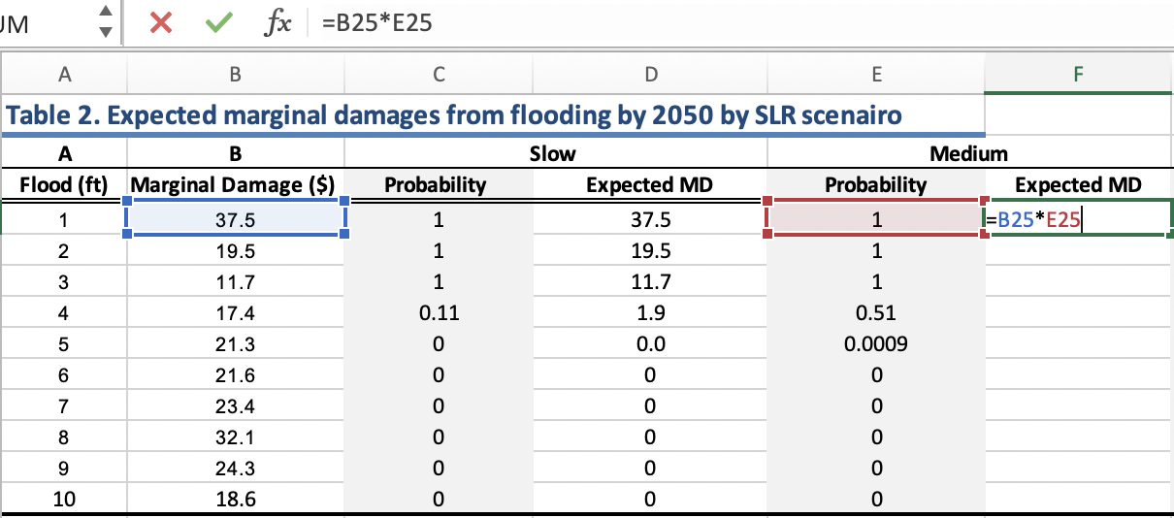
Part 1: Calculating Expected Damages from Flooding
Now you will use the formula from the previous slide to calculate the expected marginal damages for each flood level in Table 2. They have already been calculated for you for the “Slow” sea level rise scenario for the year 2050. You will calculate them for the “Medium” scenario below. (Note that the marginal damages in column B are the same as the ones you calculated above in Table 1.)
1. To calculate the Expected MD for the Medium SLR scenario in Table 2, multiply the marginal damage of flooding (x_{F,1} ) by the probability of flooding (p_{F,1} ) for a max flood height of 1ft using the formula “=B25*E25”.
2. Drag down the formula to replicate it in the rest of the column.
3. Repeat this process for the Fast and Extreme scenarios to complete Table 2.
Pause for Analysis: Discuss with a partner or in a small group how you would interpret the value in cell F29 in Table 2 in your Excel spreadsheet. Be as specific as possible.

Slide 14
Part 1: Calculating Expected Damages from Flooding
Now you will complete Table 3 which shows the expected marginal damages for the year 2100. To do this you will need to get data on the probability of flooding at each water level for the year 2100 from the Surging Seas Risk Finder website.
Note: Make sure the setting is for “Multi-year risk of flooding”
1. On the Risk Finder website for your region select the “Medium” sea level scenario on the right side of the graph and the 4 ft water level on the left side (default).
2. Hover over the year of interest on the bar chart (2050) to see the probability of at least one flood of 4 ft or higher by 2050 (51% or 0.51 for Tacoma, WA).
3. Fill out the “Probability” column in Table 3 for the Medium rise scenario by repeating this process to find the probabilities for each level of flooding for the year 2100.
4. Complete the rest of Table 3 by calculating the expected MD for the Medium, Fast, and Extreme scenarios.
Pause for Analysis: The multi-year likelihood is the probability of at least one flood occurring in the given period (e.g. 2016-2050), though there could be more. Consider the assumptions made in this analysis so far, would more than one flood occurring in the period affect the damage costs? Why or why not?

